Slide 1

e-CHAMBER FROM........
BAAC, Inc.
PO Box 1718
Tavares, Florida 32778 www.mymemberdata.com/e-chamber-details
Email: baacsupport@comcast.net Phone: 352-258-2594
The Complete system for managing and organizing data as well as producing documents for a Chamber of Commerce.
e-Chamber is FREE, BAAC has started a new program where we will earn our revenue from the chambers online directory by selling a logo/picture for your members to post with their listing.

Slide 2
e-CHAMBER....
Was designed using Microsoft Access and works with all versions of Access including both 32 or 64 bit. If you do not have MS Access, the program will run with Microsoft Access Runtime version free from Microsoft.
Automatically update your website member directory(s) directly from e-Chamber with a click of a button, view our directory at our website.
e-Chamber is an in office system, shareable in a network environment. Different from a cloud based system in that you own and control your chambers and members data, far less likely to get hacked for ransom ware. e-Chamber offers 95% of what cloud based systems offer.
If your chamber has never had Chamber Management Software, e-Chamber is a perfect 1st step into this technology.

Slide 3
e-CHAMBER Pricing
Application Fees:
For Chambers of Commerce over 250 members:
Software FREE
Annual Support Fee’s (unlimited phone/email, program updates, add your logo)
Single/Multi User User-$395/yr
Include Integration to Website Member Directory (s)-$495/yr
For Chambers of Commerce less then or equal to 250 members:
Software FREE
Annual Support FREE
Offer for small chambers is unique and integration for the online member directory is required. BAAC makes it’s revenue by selling a picture /logo to be included with the members listing. BAAC for this charges a low $20/yr fee and members with pictures are always listed first.

Slide 4
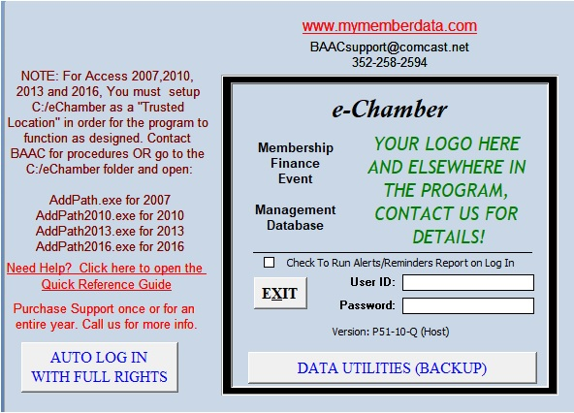
e-Chamber starts with the click of a button from your desktop and launches the Log On Screen

Slide 5
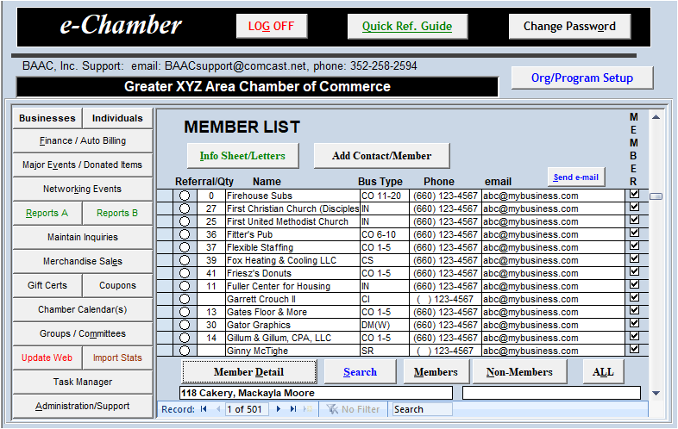
Providing the User name and Password are correct, the e-Chamber main menu loads.

Slide 6
A major selling point for e-Chamber is the ability to update your website member directory and other data directly from e-Chamber, any additions or edits to members or events can be uploaded to your website in a matter of seconds. This is done by simply clicking the Update Web button highlighted below.

Slide 7
The e-Chamber Main Menu was designed with the User in Mind. To immediately view members and search by category. In addition all major functions are easily accessed via command buttons on the left side of the screen
Organized with Command Buttons by function as follows
Master Contact Lists-All Contacts be they Members, Vendors, or just information about an area or region, 2 lists, one for Businesses and one for Individuals.
Major Events-Setup and manage both the event and participants, register and create in invoice in less then 20 seconds
Networking Event-Small Event tracking made SIMPLE, no more guessing who paid and who hasn’t and how they paid
Inquiry Entry-Designed for the user to simply input Inquires about the community and what was requested.

Slide 8
MAIN MENU Commands (Cont)
Reports A/B-
  Several Reports to run based on the wide variety of data within e-Chamber. Not what you want? Create your own with the built in Access Report builder or have BAAC do it for you as a customization.
Sales-Record all Merchandise Sales, Total and Inventory quantities automatically adjusted
Tasks-Automatically create recurring tasks (i.e. Preventive Maintenance check) or create individual tasks that may be assigned to an event or equipment

Slide 9
MAIN MENU (Cont)
  Track Committees/Boards and there members, assign and track tasks for the Committees/Boards
  Track/Manage Gift Certificates issued by the chamber and redeemed by members
  Track Members that offer a coupon, this coupon will then be included with their listing.
  Chamber Calendar, manage all the events / meetings / etc. for the chamber. Export to a Google Calendar format and import to a Google Calendar which communicates with

Slide 10
MAIN MENU Commands (Cont)
Finance-The most detailed of the options with:
  Up to 10 different registers (General Ledger) each with its’ own Reconcile Function
  Create Budgets
  Make Deposits
  Process Credit/Returns for Invoicing (Separate from Merchandise Sales)
  Create Invoices / View Open Invoices / Print Invoices
  Automatically create dues Invoicing on YOUR schedule

Slide 11
MAIN MENU (Cont)
Finance Commands (Cont)
  Enter / Pay Bills
  Print Checks
  Track and Pay Sales Tax Liabilities

Slide 12
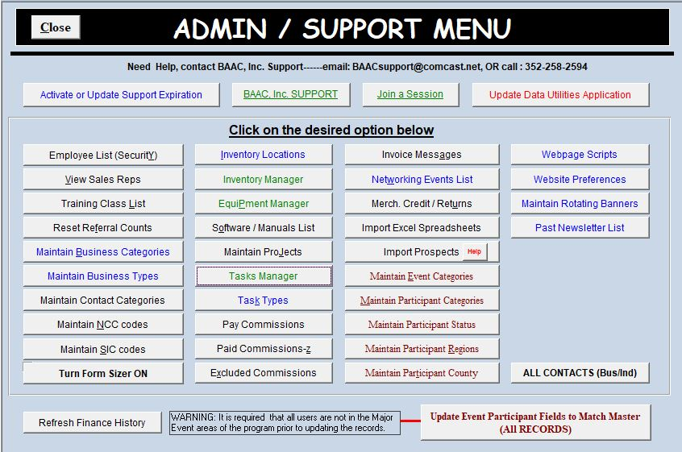
ADMINISTRATION/SUPPORT MENU: Manages Many of the field selections throughout the program such as Member Categories.

Slide 13
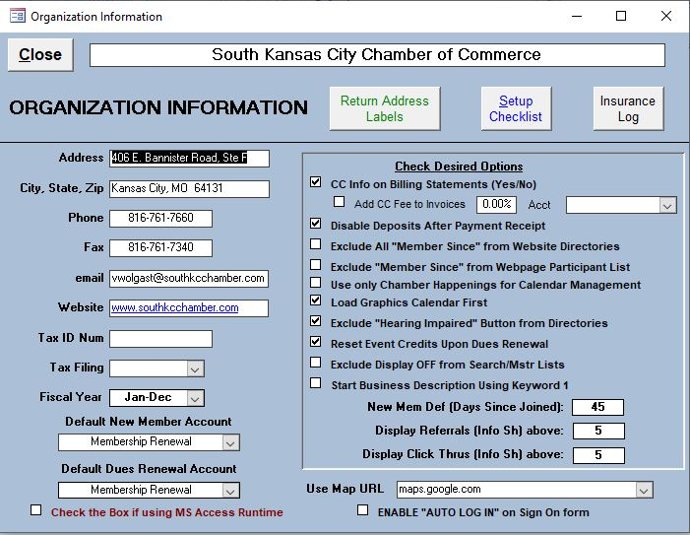
e-Chamber comes with a setup checklist to help the user get the most critical data loaded into the program. To access the setup checklist, from the main menu, clicking the organization info tab loads the form shown below
Information entered here is what appears on billing statements. Note you can print a sheet of Avery 5160 mailing labels, select your fiscal year, disable deposits (For those who only want to track paid/unpaid invoices and not use the Ledgers). Last, the setup checklist is in the upper right.

Slide 14
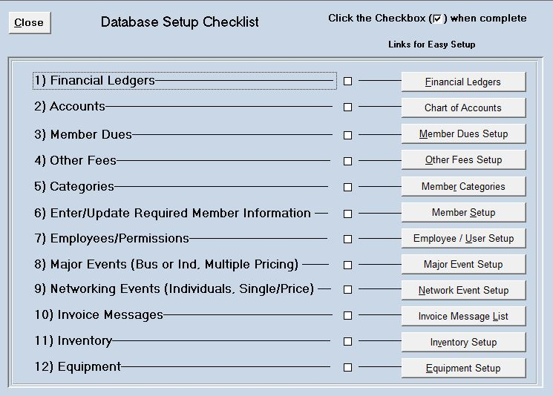
There are 12 items to choose from including setting up your financial accounts, Chart of Accounts, Member Dues, Member critical info just to name a few. We will now continue to show functions within the program

Slide 15
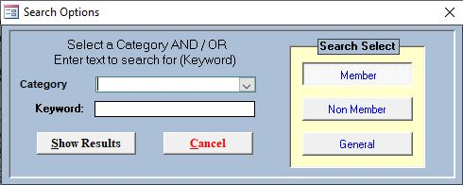
The Search Command on the Main Menu: Allows the user to search for members or non members by Category AND/OR Keywords or just perform a General search, the Dialog box that opens when search is selected is shown below:
Note: the General Search will search Name, address, city, state, zip, phone, email fields and show any matches with the user input.

Slide 16
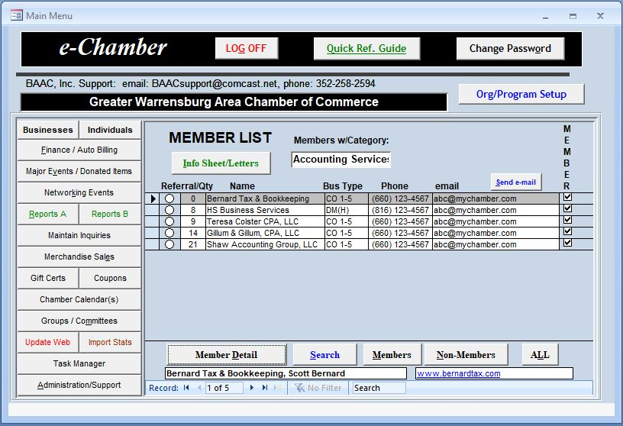
Below shows the results of a search For Accounting Services (Category). Note the record counter shows 5 matches found. You could have added a keyword of “Taxes” and this would further reduce the matching records.
Record Selection Box, click prior to viewing Information Sheet or Member Detail
Log Referrals with the CLICK OF A BUTTON, Clicking the Referral Circle Increments the Referral Count by One

Slide 17
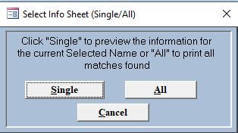
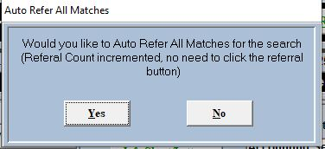
After performing a search by category, the user has the option to print an information sheet, the program will prompt the user to print either the selected member or all members found in the search. You also have the option to increment the referral counter for the selected member or all members found in the search
1st prompt
2nd prompt
The next slide will then show the information sheet

Slide 18
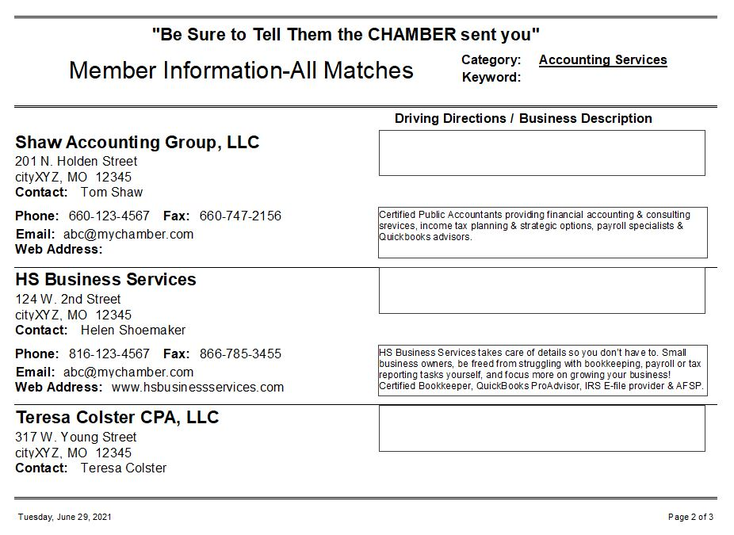
Below shows the information sheet that can be viewed/printed/faxed/emailed directly from MS Access.

Slide 19
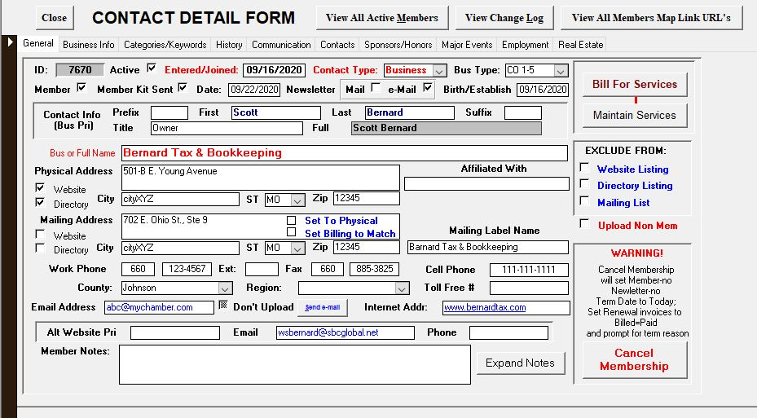
Also based on Record selected, you can click on the Member Detail button that can be used for editing existing information for existing members/contacts. Shown below is the General Info Tab, Note command buttons for Creating Bill for Services Invoice/ Cancel Membership. After these tabs are shown/explained, the Add New Member will be shown next.

Slide 20
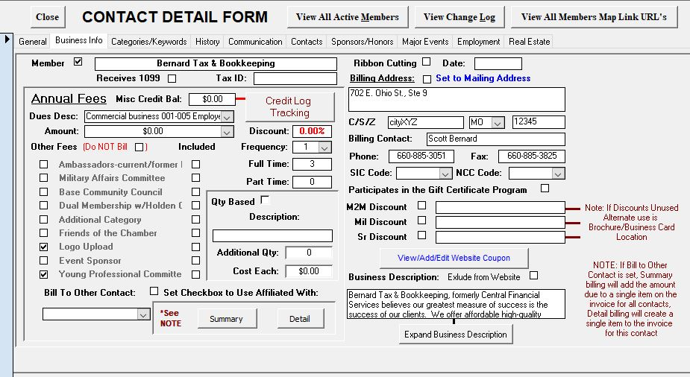
The Business Info Tab, Note the ability under annual fees to add some addition Non Dues Revenue Categories (Like Logo Upload), the user defines these optional services.

Slide 21
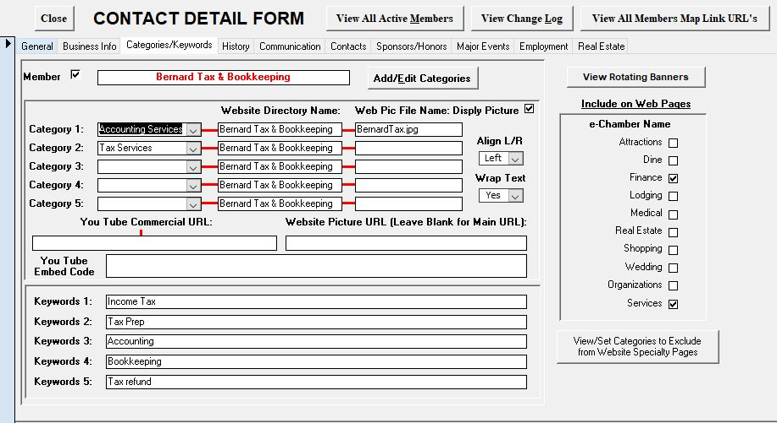
The Keyword Tab, note the ability to add up to 5 categories, also the webpic file name for the picture. Plus members can add a You Tube Commercial link to their online listing

Slide 22
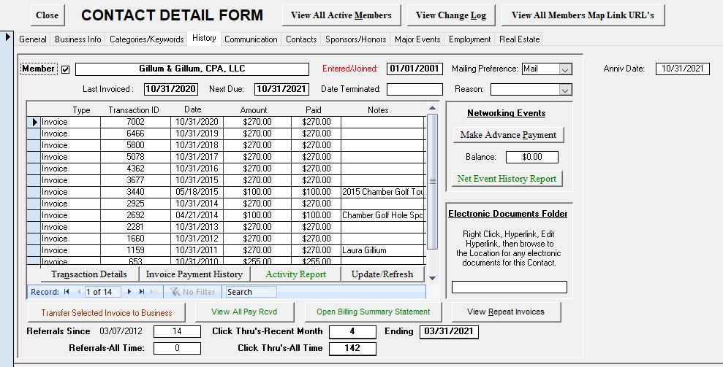
The History Tab that shows all Financial Transactions both Invoices or Bill Payments. Also note this is the location of the Referral Count shown on on the main menu list As well as critical dates such as Last Invoiced and Next Invoice due. Advance Pay options for networking events is also logged here.

Slide 23
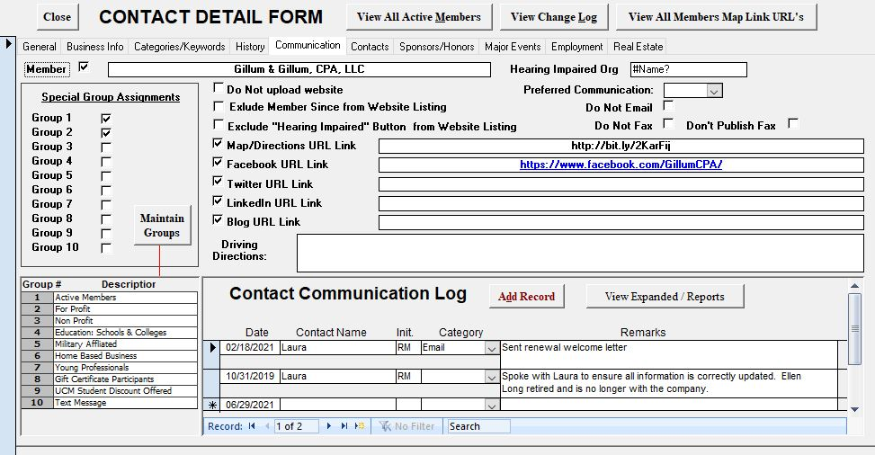
The communication log tab. Log any and all contact information with this member or non member. Also manage up to 10 Groups that you can easily get a report or email to from Reports B (Main Menu)

Slide 24
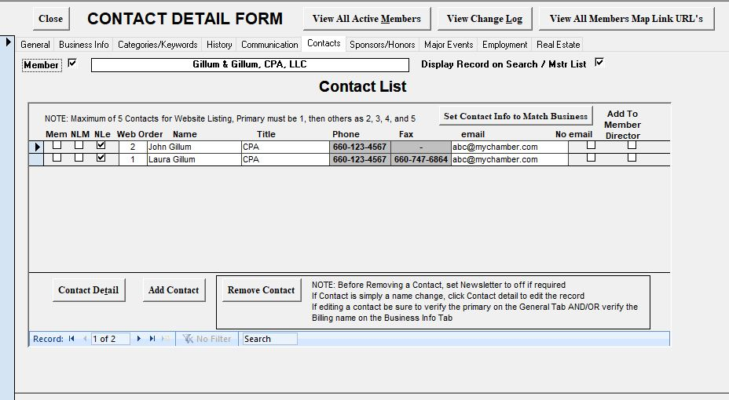
The Contacts tab. Any member or non member can have unlimited contacts (i.e. your city Government). Here is where you can also indicate if these contacts receive your newsletter.

Slide 25
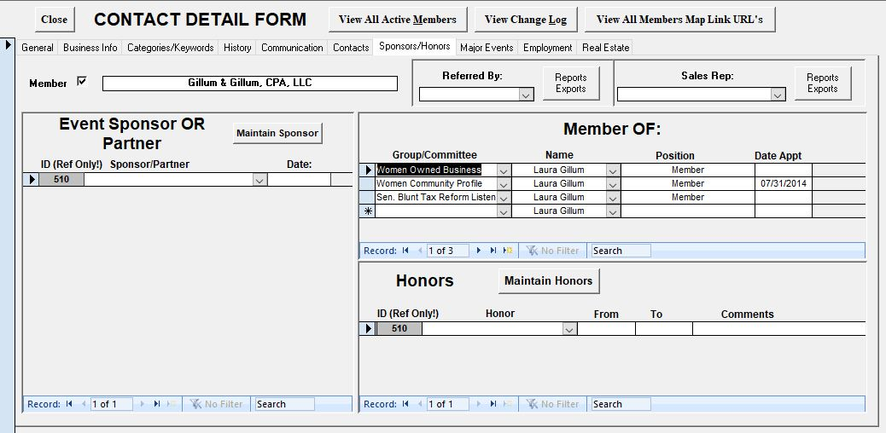
The Sponsor/Honors tab. Any member or non member can have unlimited Sponsors over time as well as documenting any honors they have achieved. Also contains a list of Committee they are on.

Slide 26
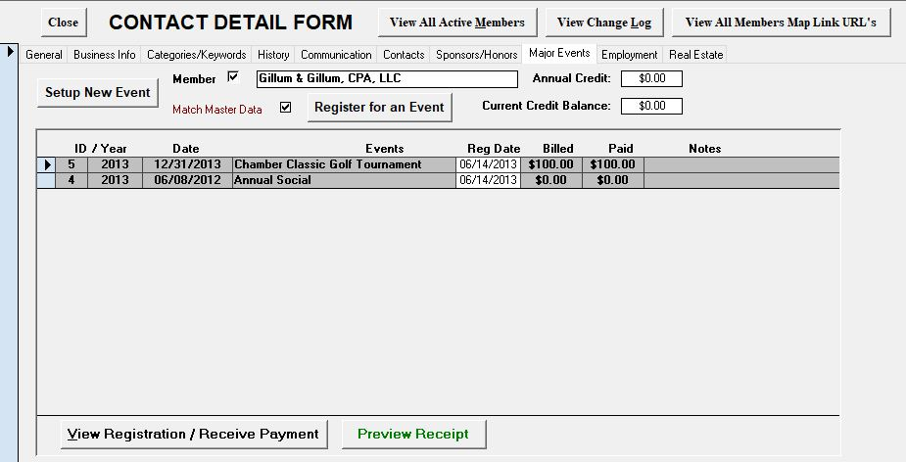
The Major Events tab. Here it is easy to register any member or non member for any event, if one is not setup, clicking the setup new event can create one. Note you can also edit Event registration selections from this tab as well. Major Events Detail covered later

Slide 27
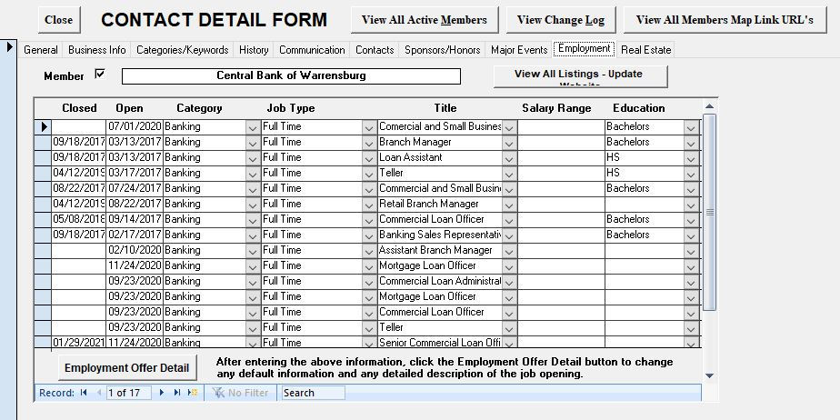
The Employment Tab-Here chambers can offer their members to post employment opportunities on their website. Only Jobs that have not been closed are uploaded to the employment Directory should the chamber opt to include that directory.

Slide 28
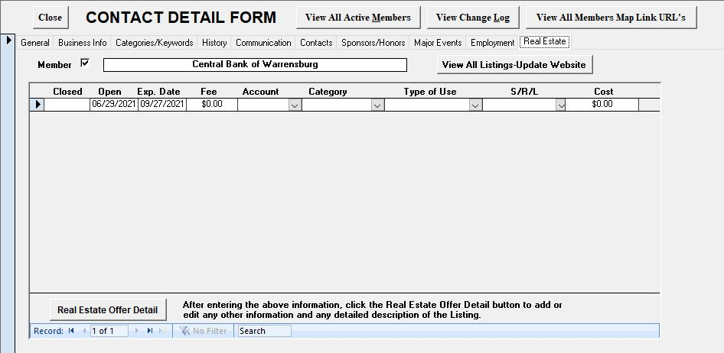
Real Estate Tab-Members can post any real estate for sale or rent, these listings can then be uploaded to a Real Estate Directory should the chamber opt for that directory.

Slide 29
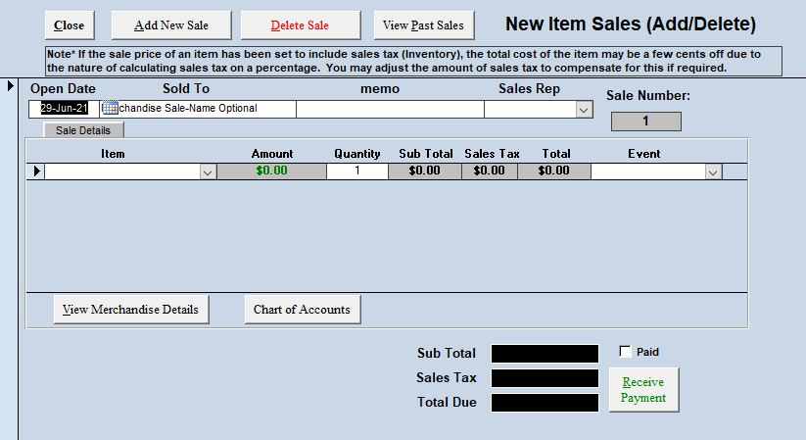
Merchandise Sales (From the Main Menu)-Only items designated as sale items in inventory appear in drop down list. Sales Tax automatically calculated as well as total bill. One sale can have many items. The next slide will show the Receive Payments window done from button at bottom.
.

Slide 30
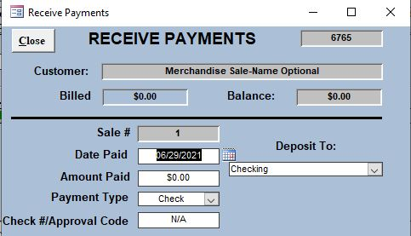
Receive Payments window for a merchandise sale. Note the date is defaulted. Enter the amount paid, and payment type. Checks and Cash will be automatically grouped with undeposited funds for deposit later while credit cards will be automatically deposited to the bank and General Ledger. After completion, the close button returns to sales for anther transaction. Credits and returns are handled in a similar fashion but reversed. Note the ability to deposit to 1 of 10 accounts with Checking the default

Slide 31
e-Chamber Facts
The remainder of the show will illustrate the remaining functions / forms (screens).
There are many functions within e-Chamber that May or May Not be utilized. This is up to the discretion of the user. You may want the system to just keep track of Members.
You will see many functions during the rest of the show. YOU DO NOT HAVE TO USE THEM, it is up to you.
The important Fact, ALL functions come with the program, we do not itemize by function.

Slide 32
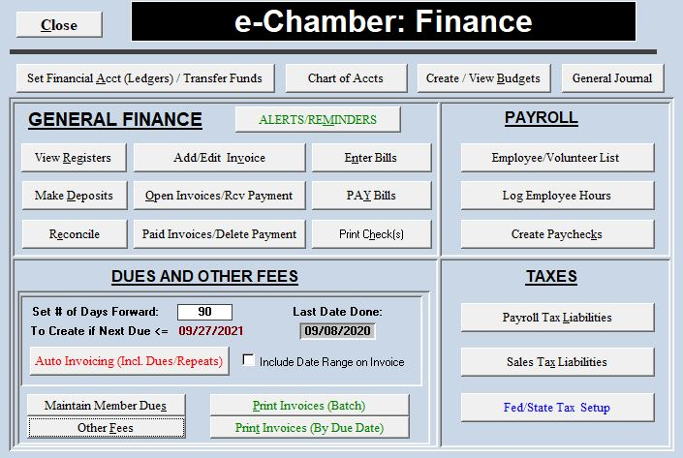
The e-Chamber Finance Menu, note the Auto Invoicing button circled below. This will automatically create invoices when they are due and also check for errors as shown on the next 2 slides. Set Days forward to create invoice due before the date.

Slide 33
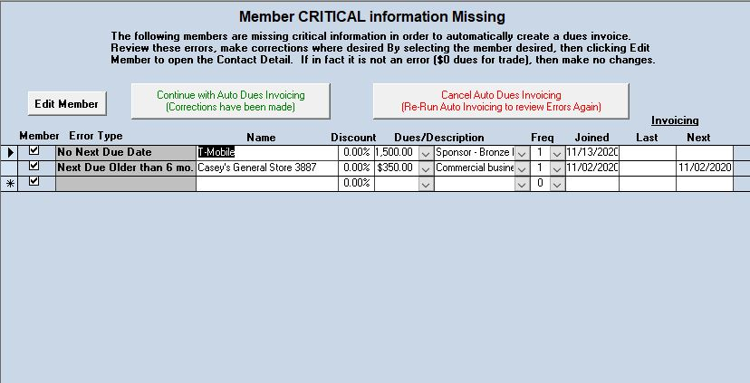
After clicking Auto Invoicing, e-Chamber does error checking on all members prior to creating invoices with the error type. The user can correct these errors here prior to continuing by clicking Continue circled below. Click Continue with No errors.

Slide 34
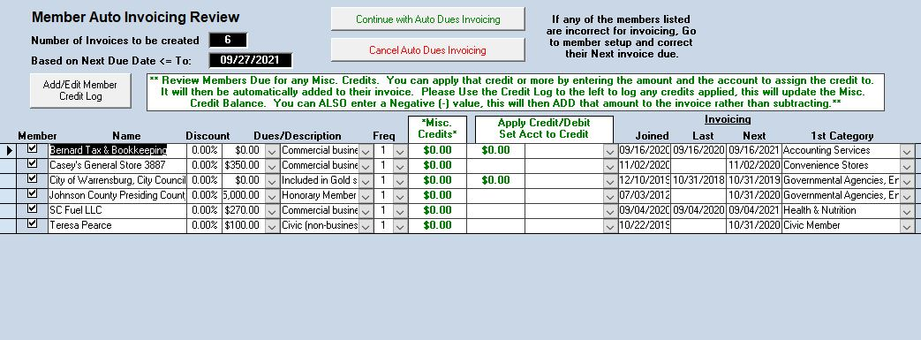
Last, you can view the members who will have invoices created based on the Next due date set on the finance menu. To create the invoices so they appear on the open/closed invoice form, click the Continue button circled below. Once completed you can then click Print Invoices (Batch), select the date and continue. Invoices also now appear in Open Invoices to Rcv Payment

Slide 35
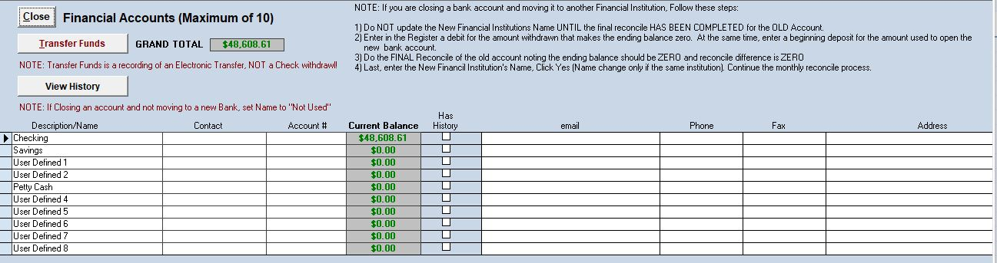
Bank account setup from the Finance Menu-All balances will be 0 until you enter the beginning balance in each register or ledger. NOTE the transfer funds function

Slide 36
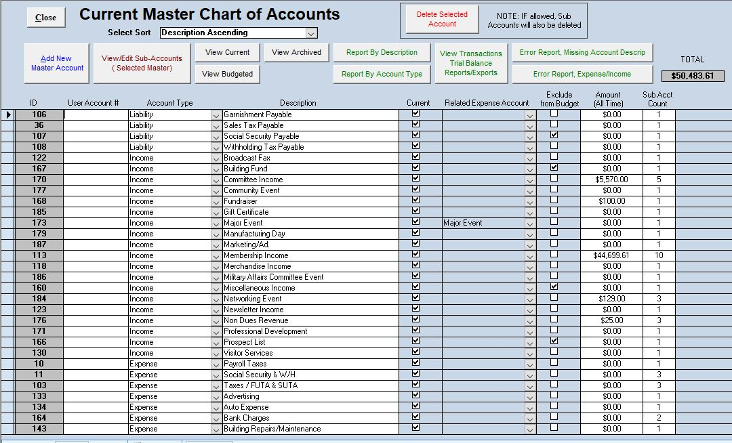
Second, you setup your Master chart of accounts-Note the Account # field that can be used as a cross reference to an accountants system.

Slide 37
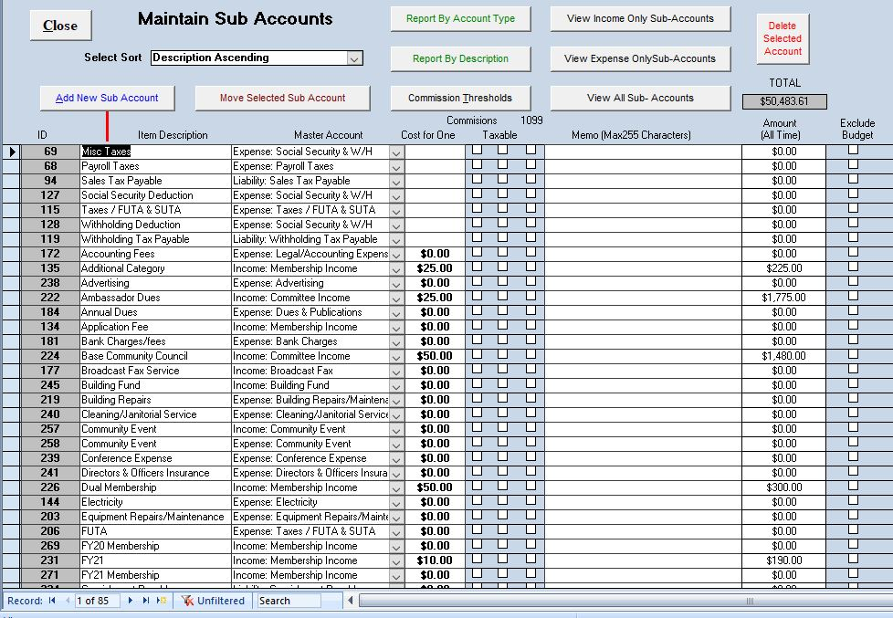
You than can create items or sub accounts to assign to the master accounts created. This allows the program to create the Profit and Loss statements as well as track costs by items. Tracking these to budgets is also automatic.

Slide 38
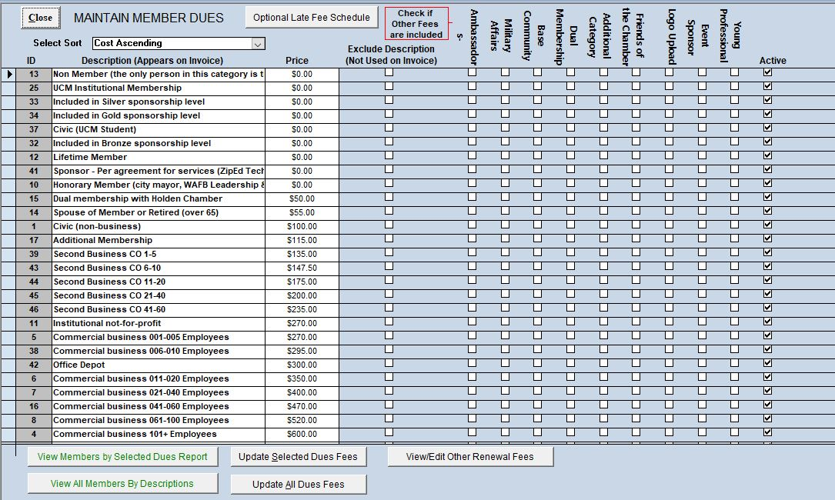
From the Finance Menu, e-Chamber allows for unlimited dues structures that are used to assign to a member. The program also allows for a global update of dues when increases occur or you can update the fee for a single dues description.

Slide 39
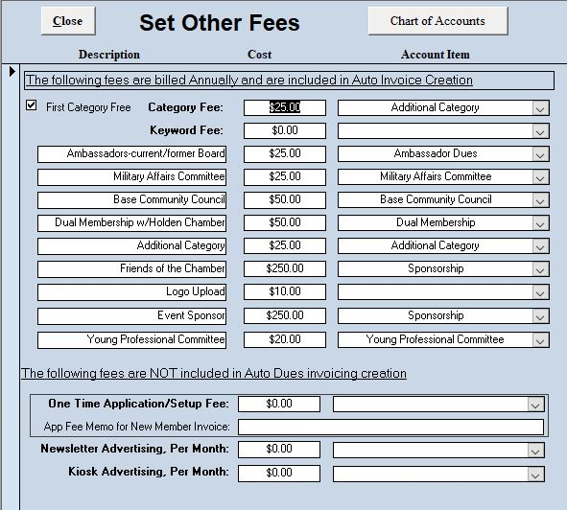
From the Finance Menu, e-Chamber also allows the user to setup fees that are used in auto invoicing of member dues. Up to 9 additional fees (defined by the user) can be setup. There are also 3 fees that can be set for application/setup, kiosk, and Newsletter advertising.

Slide 40
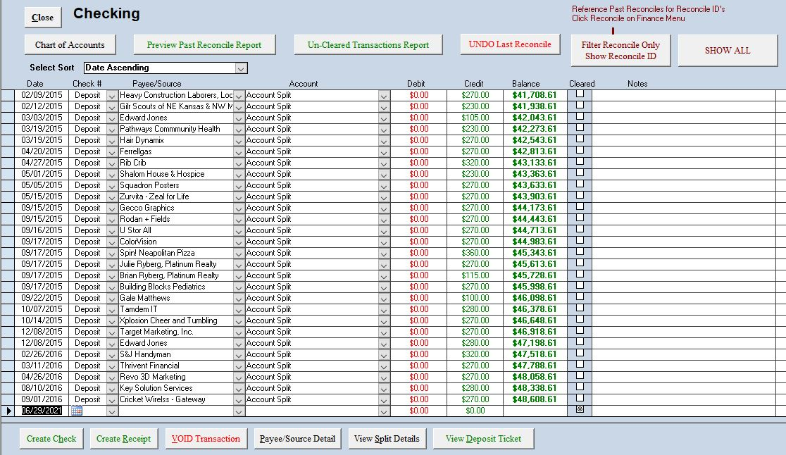
From the Finance Menu, you select which of the 10 Register you want to view. The Checking Register is the default, Note the ability to Void any transaction from the ledger, the program knows what type of transaction it is (Bill, Invoice Payment, tax payment, etc) and will handle it appropriately. View Split Details circled below to see the accounts assigned.

Slide 41
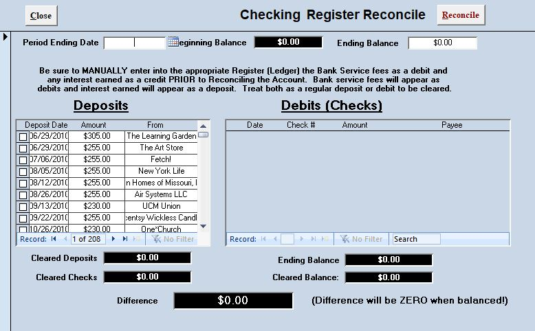
The Reconcile Form-one for each of the 10 accounts. Enter Period Ending date, Ending Balance. Check deposits and debits on bank statement. If balanced, Difference will be ZERO, you can then click Reconcile in the upper right. Reconciles can also be “Undone” from the related Register.

Slide 42
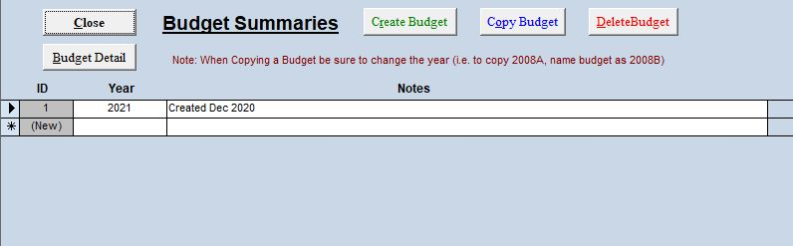
From the Finance Menu, the Budget Summary Form-Note, create multiple budgets for one year or create a budget for events. Select and click Budget Detail

Slide 43
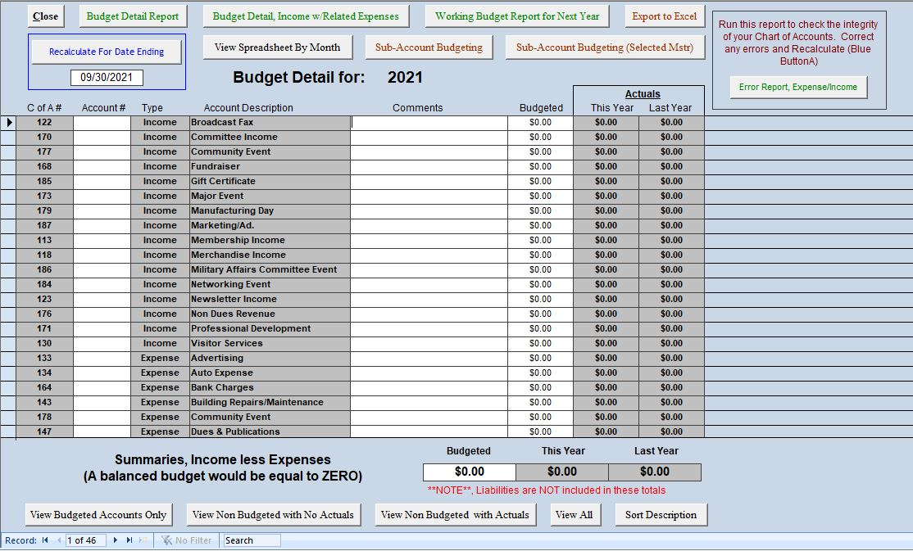
The Budget Detail Form, note the program will track actuals for each account item for the current year and the previous year. You enter the amount to budget for that year. You can also do sub account budgeting and then view reports on Budgeted vs. Actual throughout the year.

Slide 44
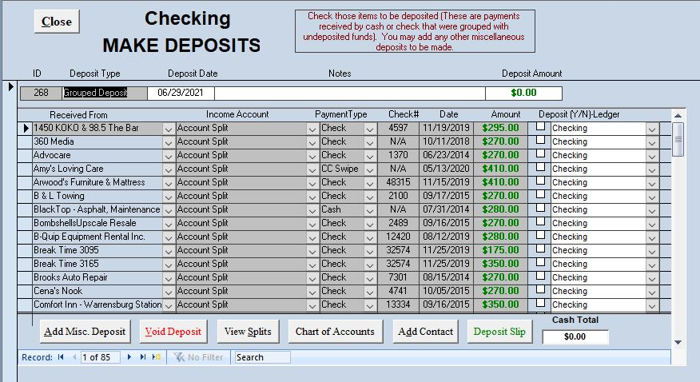
From the Finance Menu, make deposits window. Records are automatically created when receiving cash, check or Credit Card Batched payments. Select the deposits desired. Also note the ability to Void a deposit from this view. Once you have grouped all click Close to record to the related register.

Slide 45
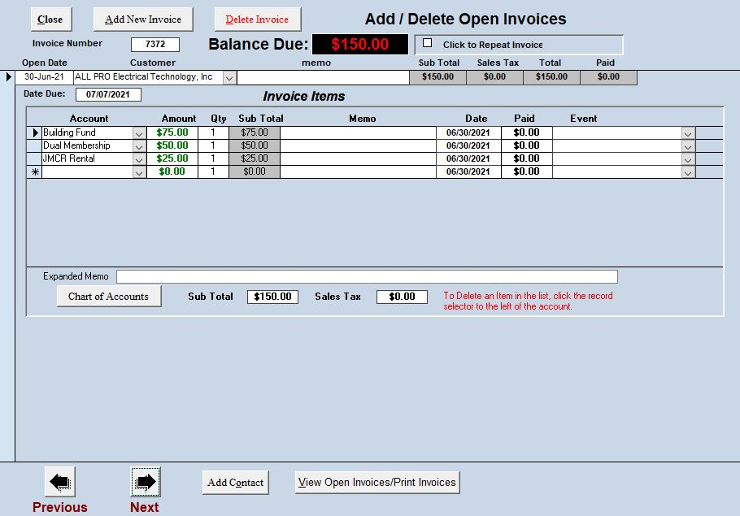
The Add/Edit Invoice form. Note that multiple items can be attached to one invoice to allow account splits-Also note you can assign an invoice item to an event as an option. Invoices can be manually created for member or non members. To Edit an invoice you put your cursor in the Invoice number field and use the Control F on your keyboard to find that invoice number.

Slide 46
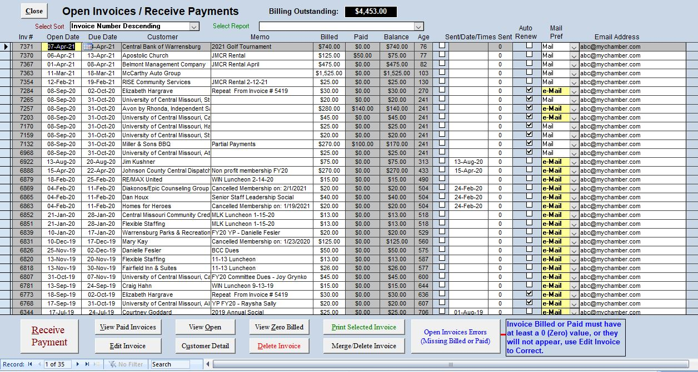
The open invoices form. Receive Payments similar to Merchandise Sales. Invoices created automatically for Member dues . Note links to Invoice Detail and print Invoice function. A sample invoice is shown on the next slide.

Slide 47
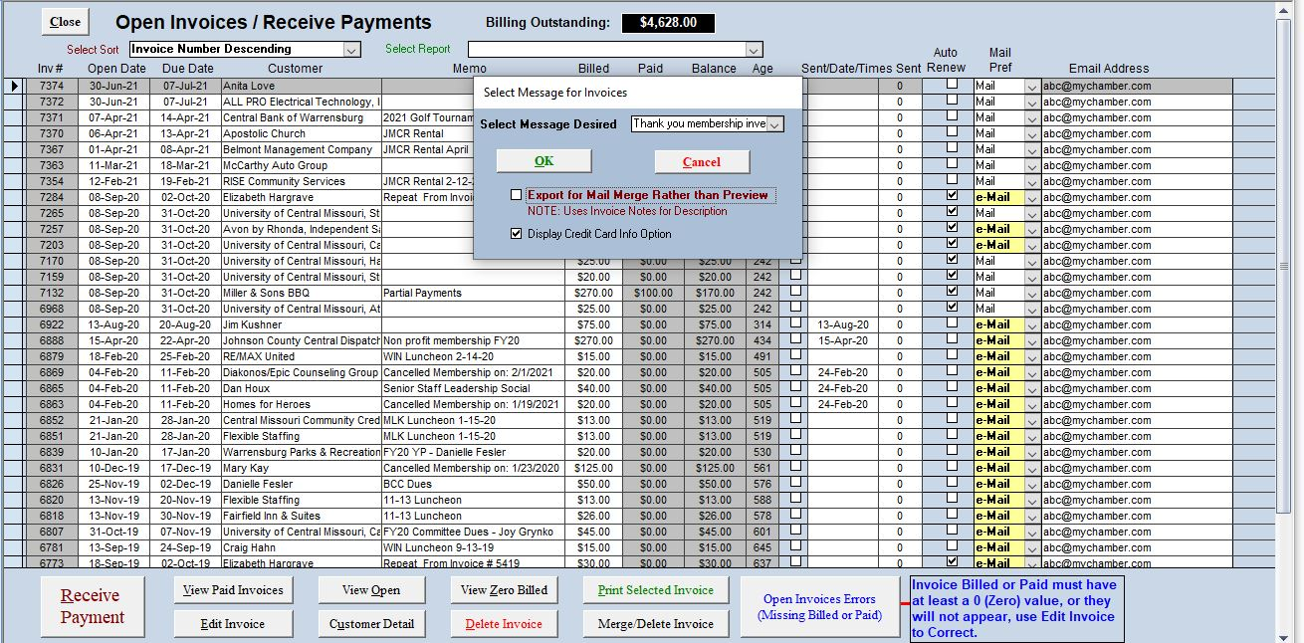
When you print invoices in batch or single you will be prompted to select a message. These message options are created by the user in the Administration Menu.

Slide 48
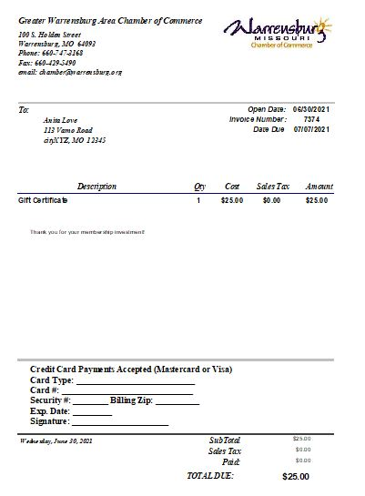
The invoice once open can now be printed or emailed, also note this again is a custom report that chambers can instruct BAAC how they want it to look.

Slide 49
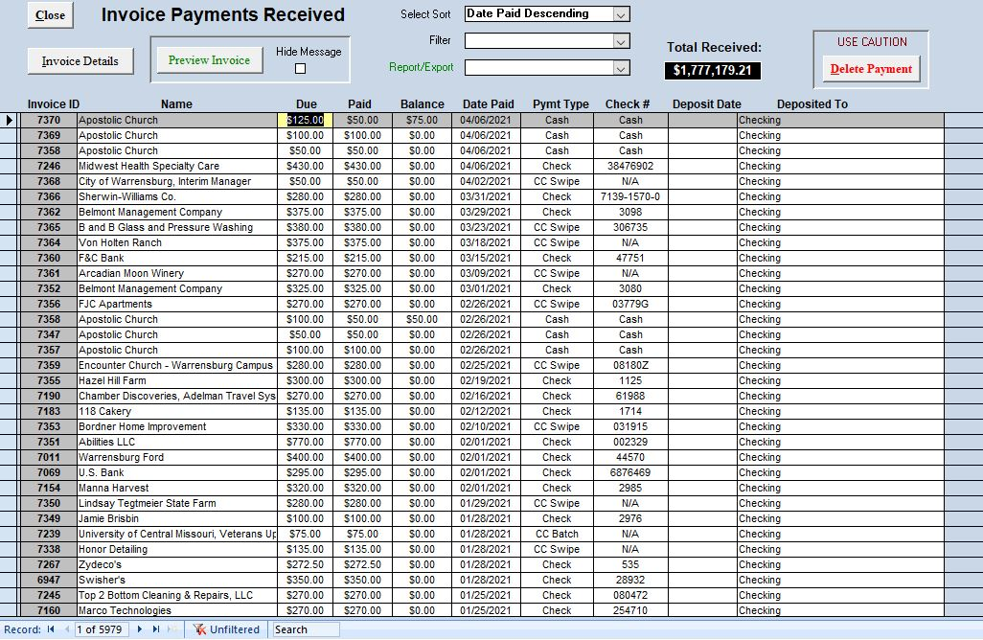
From the Finance Menu, the paid invoices form. This is history All time with some built in reports. Also note the ability to Delete a payment which would return the invoice to Open Invoices.

Slide 50
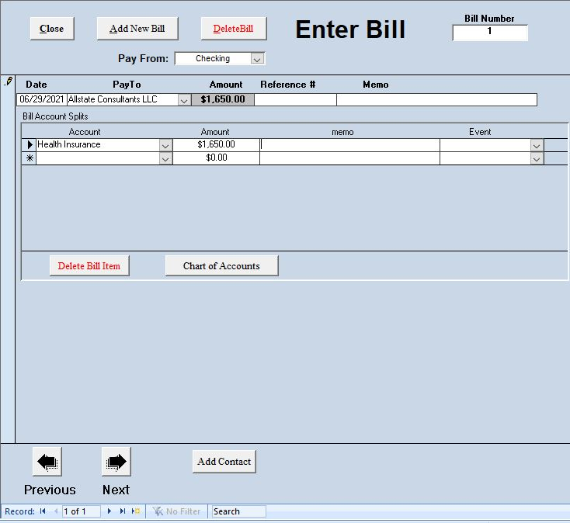
The Enter Bill Form. The process for Bills is Enter, Pay, then Print (all selectable by the user). Note that items can be assigned to an event for cost tracking. NOTE: If Bills are assigned to a single account, the user can also directly enter them into the appropriate directory and skip Enter and Pay Bill

Slide 51
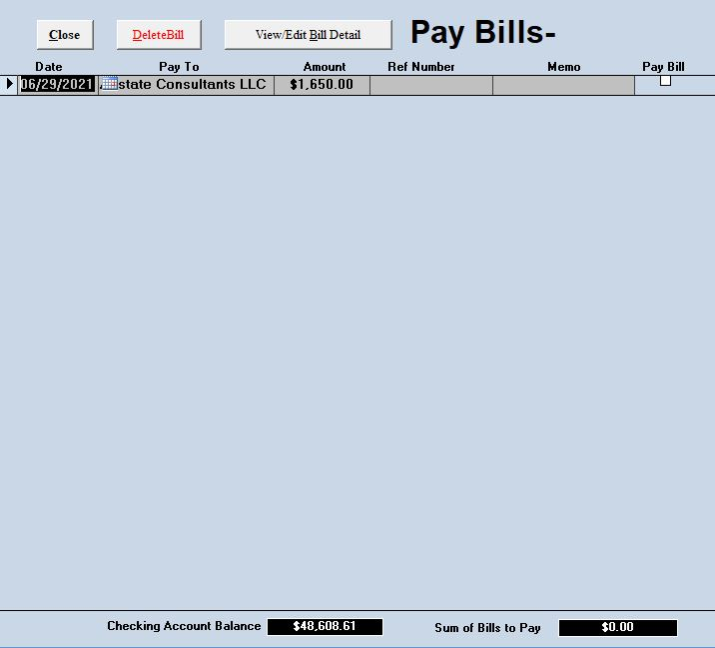
You the user selects which bills to pay based on those entered. Note the checking account balance is visible and adjusts for each bill you select to pay

Slide 52
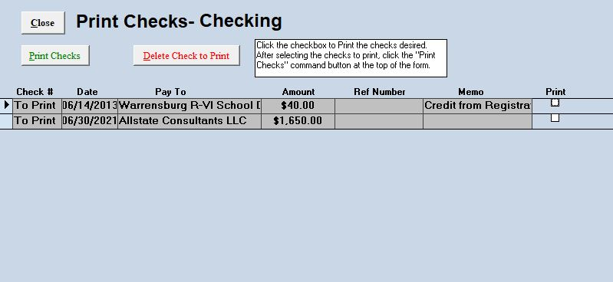
Any Bills selected to Pay will be on the Print Checks List. Just as in Bill to pay selection, you the user selects the checks to print. Checks are formatted for Voucher checks but can be modified for standard 3 to a sheet checks. Prior to opening the program will show the next check number, if incorrect or the first time using simply enter the check number to use.

Slide 53
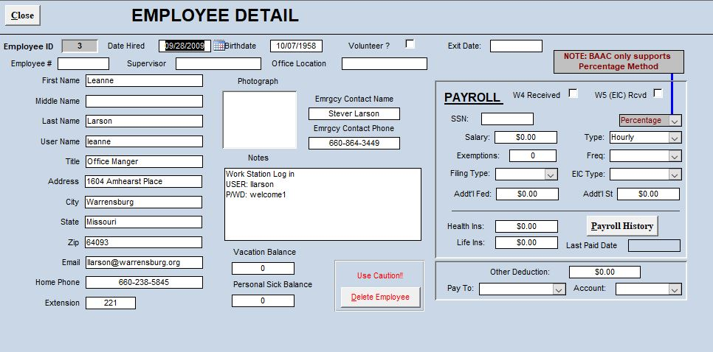
e-Chamber provides for data on each employee/volunteer, note the Payroll information. Users can use this to have the program create paychecks and the program calculate state and federal taxes due. Users also have the option to just enter Paychecks as a bill directly to the register, same as taxes due that were manually calculated or provided by and accountant.

Slide 54
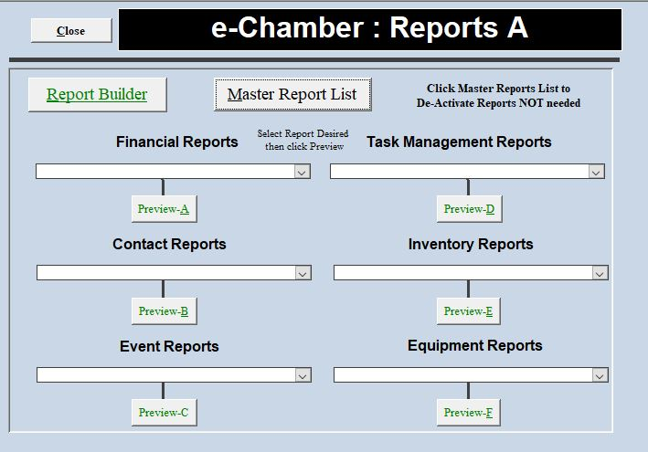
The Reports A Menu, we will show a few examples in the next slides, there are to many to allow showing them all, well over 200 reports in e-Chamber. Reports are organized by function. Note the Report Builder. This allows the user to create their own reports outside of e-Chamber using real time data.

Slide 55
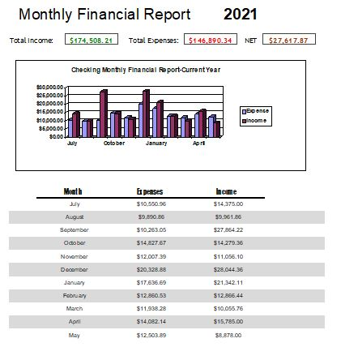
The Monthly Financial Report showing Income and Expense for the current year.

Slide 56
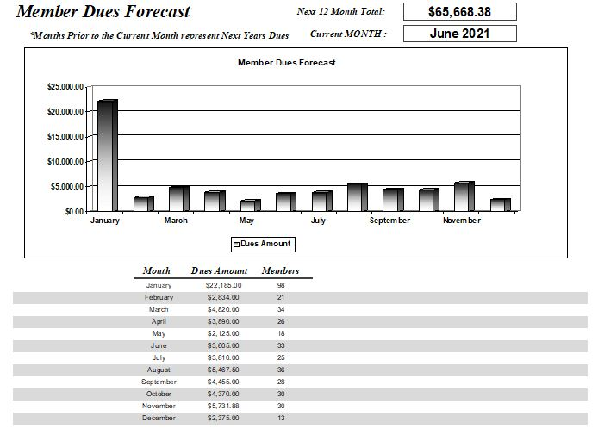
The Dues Forecast Report

Slide 57
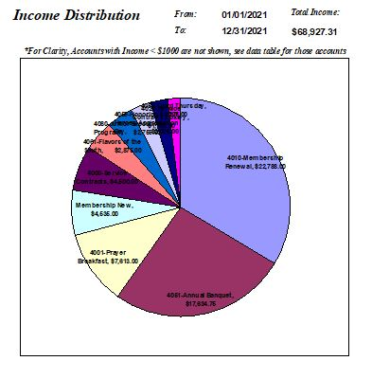
The Income Distribution Report by desired date range. Actual Dollars are given on page 2 of the report. There is also a matching report for Expense Distribution.

Slide 58
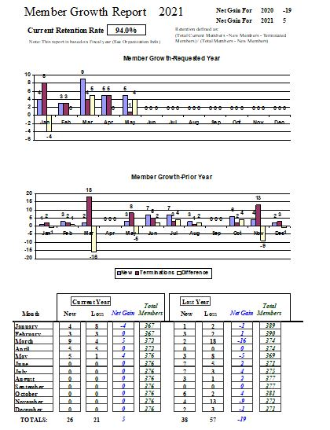
Member Growth and Retention Report. Report is based on fiscal years so comparisons can be made to prior years. Retention Rate applies to the instant in time the report is run.

Slide 59
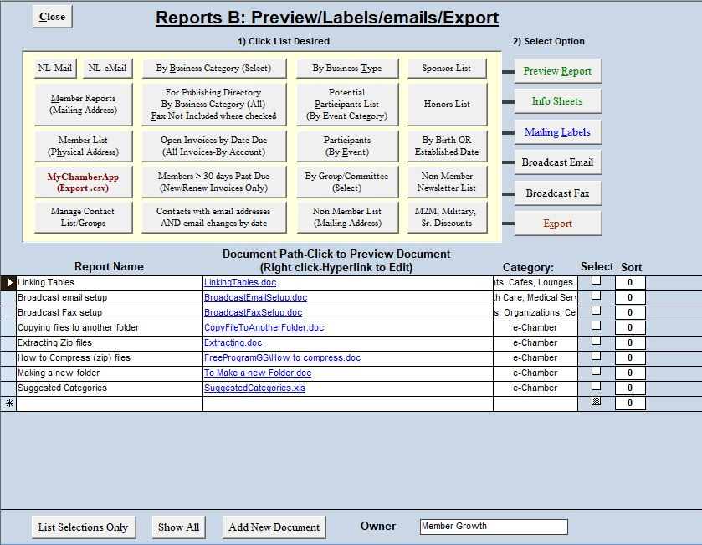
The Reports B, View unlimited documents based on list selection (merged) and create Mailing labels or an MS Excel file. Or just simple view a report based on the button selected. 1) tell the program what you want (the yellow box), then 2) what do you want to do with it (the far right column). Note there is also a list of documents you can link to as well.

Slide 60

When clicking Major Events, the program will prompt you to select an event to view (it’s setup and registered participants) or go to a Master Summary List shown in the next slide. If you are setting up a new event, you will click the Setup New Event button. Note you can also Log Donated Items which also has a feature of printing Bid Sheets for Silent Auctions.

Slide 61

The Major Event Master Summary List provides a snapshot view of all major events ever held. Not you can open/close events, contacts can only register for open events. It provides you with how many participants and what if any outstanding monies are due. You double click an event or click View Detail for the event and view participants. Create Evaluations as well.

Slide 62

Major Event Detail Page 1, Note you can even type instructions for the event registration options! Here you define the descriptions and prices for the event. Several reports and export of attendees is also allowed from this form. Also note you can see the number of participants currently registered and view that list to edit, view their detailed registration options. Participants list is shown after the next slide which will be Page 2 of Event Detail (Event Additional Fees and Options button)

Slide 63

Event Options, the capability exists to enter up to 10 Additional sale items that are all quantity dependent. Participant registration will then have the option to select these items and quantities when registering, fees and taxes are automatically calculated. You can also define up to 10 Yes/No fields, in this case one is used for Need Golf Cart. These options are not fee based.

Slide 64

After you setup your event (only once! And you can copy it) you can now register a participant. The Master Participant List-This is all participants for all events, to register a participant, you will search from the main menu to find them, open the contact detail, go to major events, click Register for an event, select it and continue. It takes less than 30 seconds and you can print an invoice at the end of the registration process or from this participant list. Note you can also upload to website

Slide 65

Shown here is the prompt when you click Register for an event on the Contact Detail (from the Main menu list) Major Events tab. You select the event and only OPEN events will be available. Note you can also from the Major Events History for that contact view any Registration information from any events they attended by clicking the View Registration/Receive Payment in the lower left (based on record selected).

Slide 66

You then select the event the participant is registering for (The event setup is automatic). Simply check the boxes the participant desires and the quantity. When complete you click the Step 2 button. Note you can also add any non-paying attendees that will accompany this participant. Also you can assign badge/booth # or Apply Discounts

Slide 67

For Step 2, you will now check any additional items purchased, their quantities and the yes/no options and their quantities. Amount owed is automatically calculated at the bottom of the form. You have the option to receive the payment now or later using the edit registration feature. Note, if after editing the participant has overpaid the receive payment button acts as a create check function for a refund.

Slide 68
For Step 2, you will now check any additional items purchased, their quantities and the yes/no options and their quantities. Amount owed is automatically calculated at the bottom of the form. You have the option to receive the payment now or later using the edit registration feature. Note, if after editing the participant has overpaid the receive payment button acts as a create check function for a refund. To finish and have an option to print an event invoice click Finish at the bottom. The next slide will show the event billing invoice.

Slide 69

Once you preview the Event Billing Invoice, you can print or email as needed. Note billing statements are custom for each Chamber we support and you have an option as part of support to change any reports with your Logo. We will perform those changes for you.

Slide 70

From the Main Menu, there is a networking event management function (meetings/luncheons/etc.). When selected, the prompt below requests the event and date. Note you can view both ongoing scheduled events OR Archived events. Clicking continue will then load the form on the next slide

Slide 71

A list of attendees entered to date will appear. Note you can 1) print a report, 2) Print Name Tags, and 3) Receive payments (Free, cash, credit card, check, etc.). You are not allowed to close the event until Total Billed is equal to Total Paid. Also Note you can copy this list of attendees to the same event on another day, then just remove those that don’t attend and add ones not listed. Really reduces data entry for managing networking events which if for Individuals only.

Slide 72
This Concludes the Slide Show for
e-Chamber
Thank-you for watching the show and hope you can see the value e-Chamber can bring to your Chamber of Commerce/Members.
There are many other functions to the program such as managing Equipment and Inventory as well as Work Orders like Preventive Maintenance tasks.
If you are interested in this program and would like assistance in installing and/or support please contact Ron Oimoen at:
352-258-2594
baacsupport@comcast.net

